Slide 1

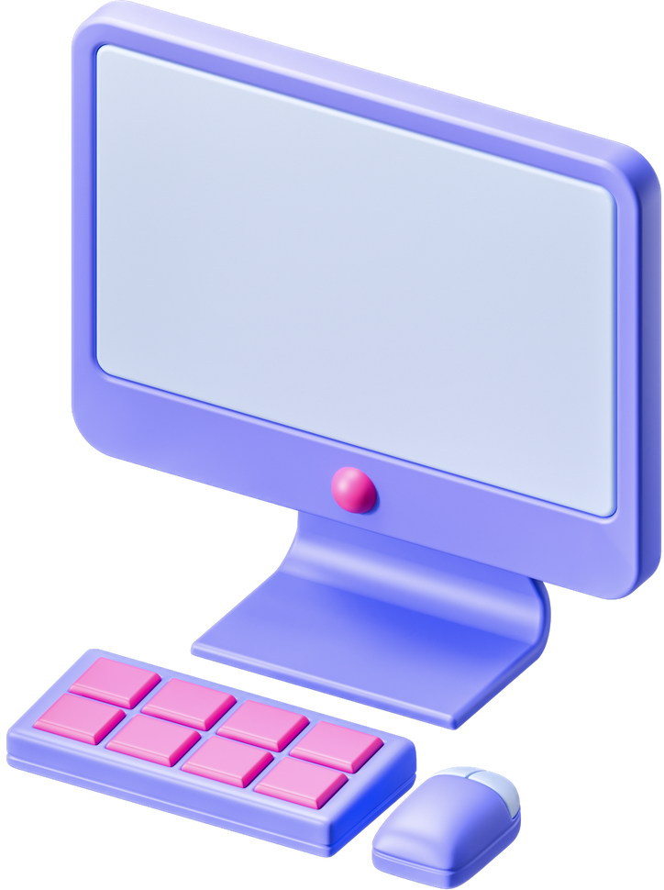


Computer Fundamentals and Components
Understanding the Basics of Computing.

Slide 2


What is a Computer?
Definition: A computer is an electronic device for processing data.
Features: Speed, Accuracy, Automation, Storage.
Examples: PCs, Laptops, Servers, Smartphones.

Slide 3
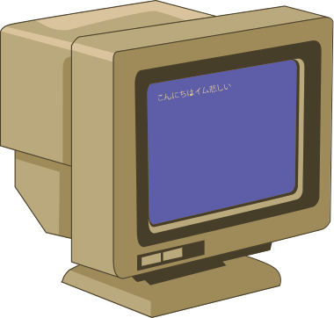

Computer Functions
Input: Data is entered (e.g., using a keyboard).
Processing: CPU processes data using instructions.
Storage: Temporary (RAM) or permanent (Hard Drives).Output: Results displayed or printed (e.g., monitors).

Slide 4

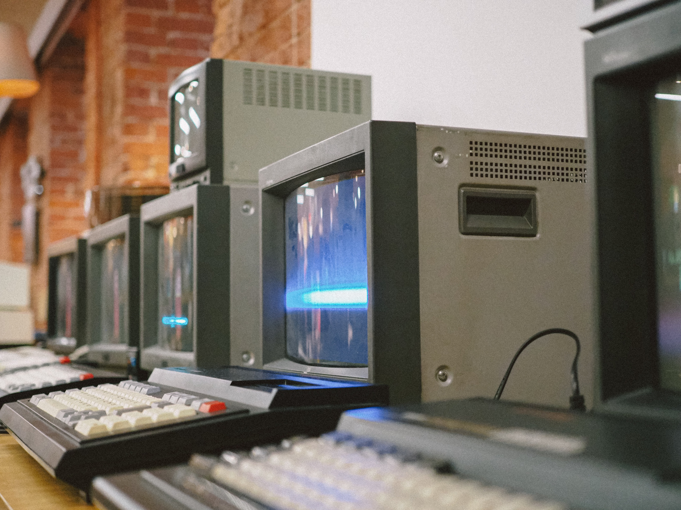
Types of Computers
Based on Size: Microcomputers, Minicomputers, Mainframes, Supercomputers.
Based on Purpose: General-purpose vs. Special-purpose.

Slide 5
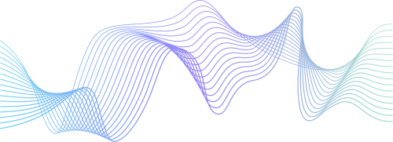

Hardware Overview
Physical components of a computer system.
Examples: Motherboard, CPU, RAM, Storage Devices.
Categories: Input, Output, Processing, Storage.

Slide 6


Input Devices
Devices to input data into a computer.
Examples: Keyboard, Mouse, Microphone, Scanner, Webcam.

Slide 7
Output Devices
Devices to display or output data.
Examples: Monitor, Printer, Speakers, Projectors

Slide 8

Central Processing Unit (CPU)
Brain of the computer.
Components: ALU (Arithmetic Logic Unit).
CU (Control Unit).
Registers.
Speed measured in GHz.

Slide 9
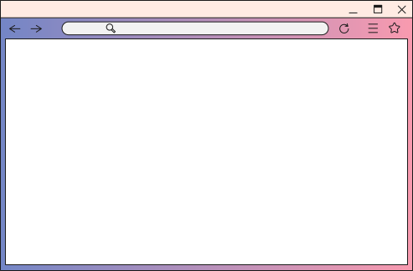

Memory and Storage
Memory: Temporary data storage.Examples: RAM, Cache.
Storage: Permanent data storage.
Examples: HDD, SSD, Optical Discs, Cloud Storage.

Slide 10
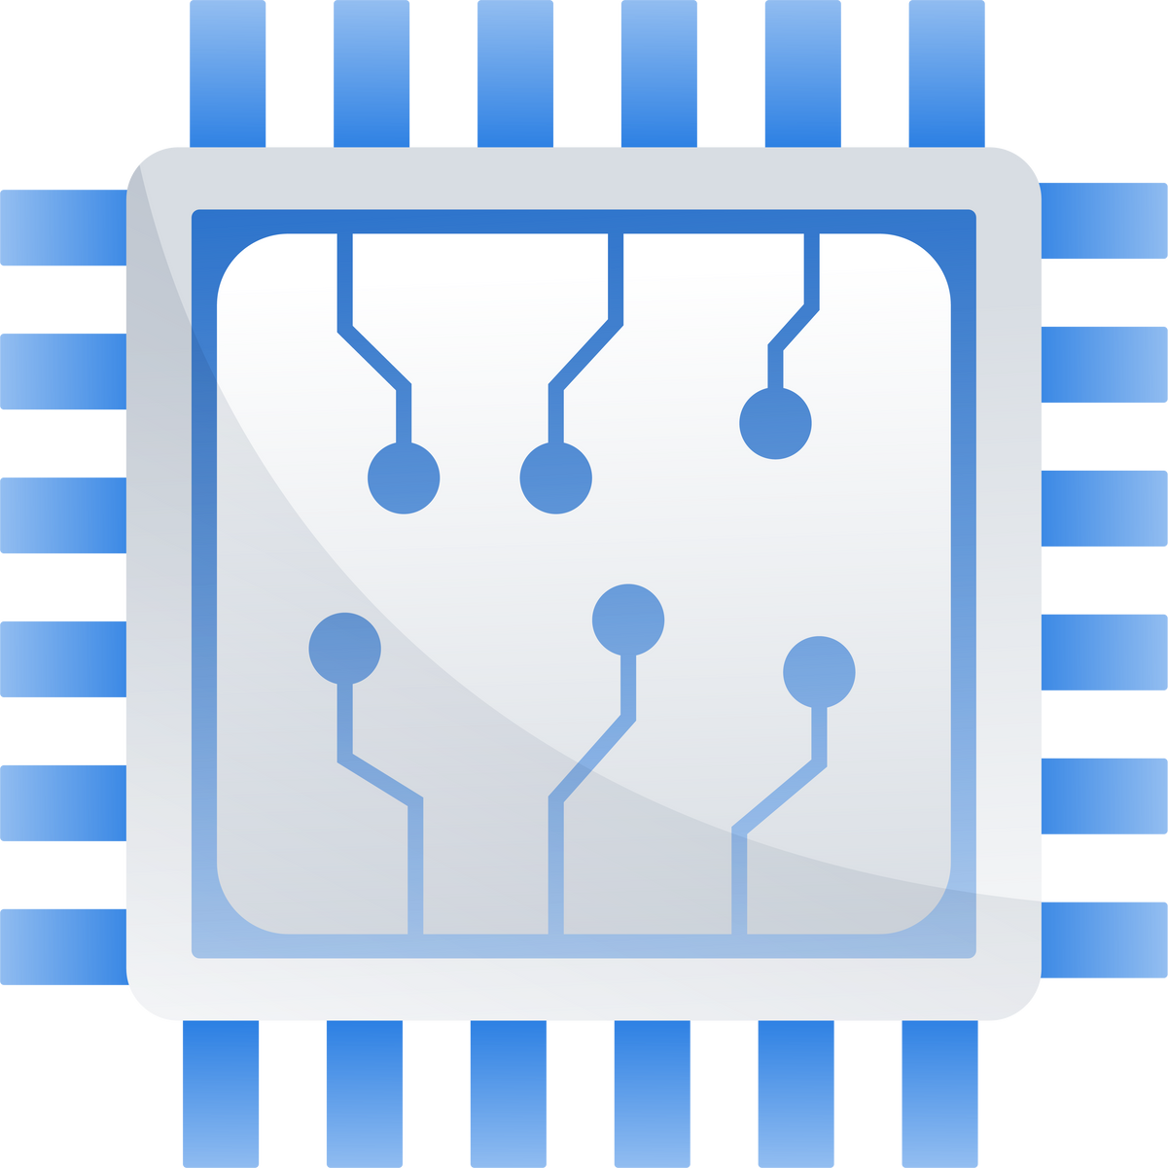
Motherboard and Bus System
Motherboard: Main circuit board connecting all components.
Bus System: Transfers data between components.
Data Bus, Address Bus, Control Bus.

Slide 11
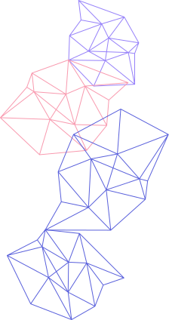


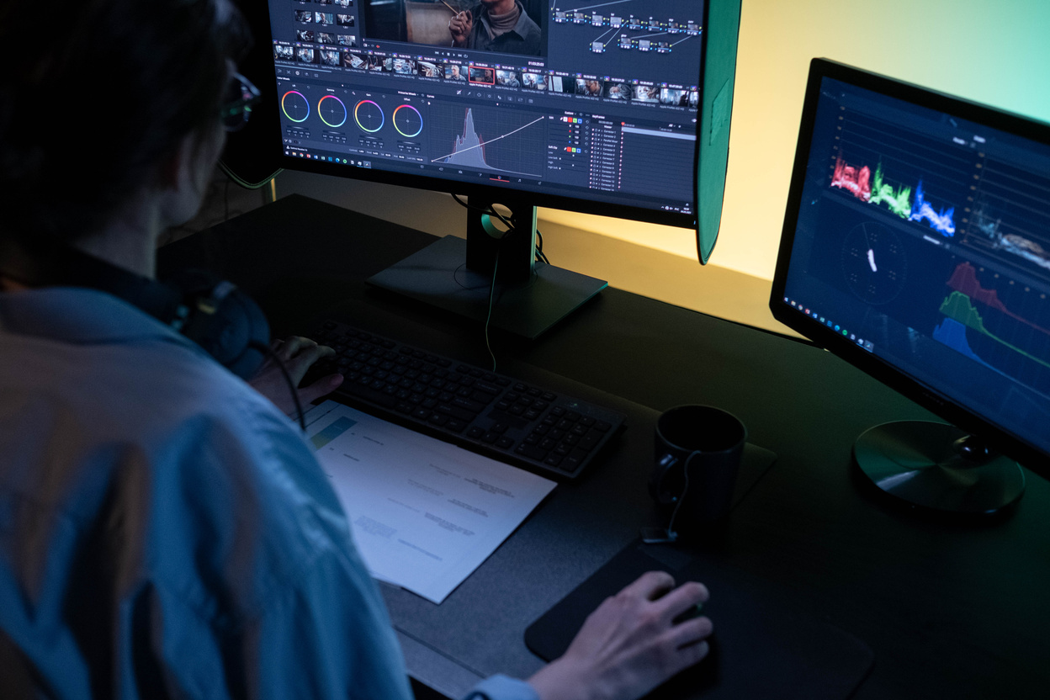
Software Overview
System Software: Operating Systems (e.g., Windows, Linux, macOS).
Application Software: Productivity tools (e.g., MS Word, Photoshop).
Utility Software: Tools for maintenance (e.g., antivirus).

Slide 12
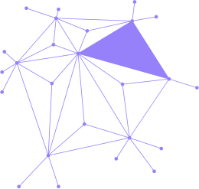
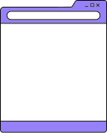
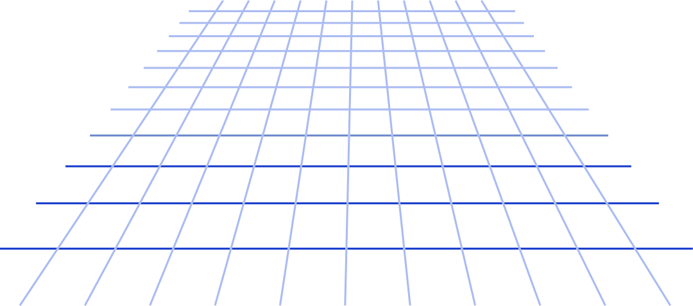
Devices enabling data transfer and connectivity.
Examples: Modem, Router, Network Card, Switch.
Networking Components

Slide 13

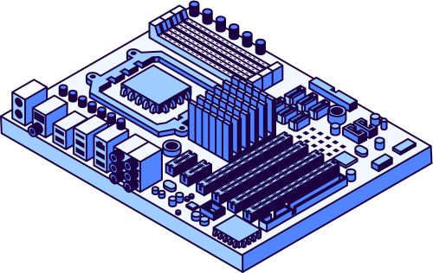
Basic Computer Workflow
Data flow: Input → Processing → Storage → Output.
Example of a real-world workflow: Typing a document and printing it

Slide 14

Trends in Computing
Evolution of Hardware (e.g., Quantum Computing).
AI and Machine Learning.
Cloud Computing and Edge Computing.

Slide 15
THANK YOU

